Slide 1
Subversion
Gaining familiarity with the system
Excellent for looking over documents more than one person is working on
Allows you to track individual changes at specific times
This will be quite useful in the coming weeks as we actually play around with code

Slide 2
Examining coordinate systems
Astronomical coordinate systems
  Geographic: rotates with the Earth
  Geocentric equatorial inertial: stationary
Good for faraway objects e.g. stars
Earth isn't spherical: Need to account for oblate spheroid shape
  Geodetic coordinate system
Programming transformations in IDL

Slide 3
Stellar Calibration
Going to attempt to use some stars to calibrate photometers and all sky cameras
Pros
  Plenty of literature
  Yale Bright Star Catalog
Cons
  Devices were not meant to examine stars

Slide 4
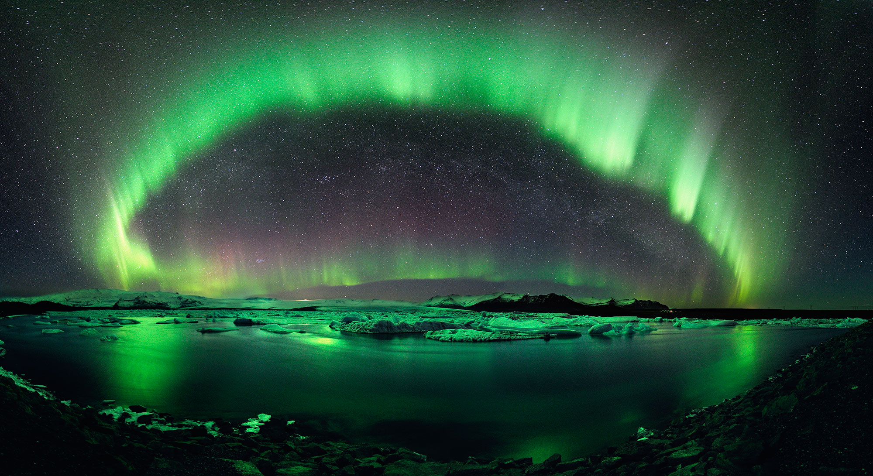

Slide 5


